Slide 1
TECHNICAL FOUNDATIONS OF MY MARKETPLACE HACKATHON
All requirements are written in the document

Slide 2
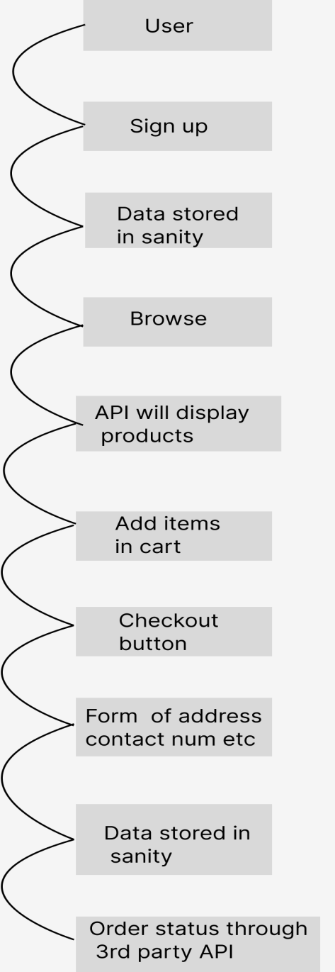
System Architecture
The whole architecture of the website is defined in this picture.
User will sign up.
User data will be stored in sanity
The API will provide products details as the user visits product page
As user adds items in cart and clicks on checkout button a form will appear
After submitting form the data will be stored in sanity
The user will get the status of the order from Order details page and the status will be from a 3rd party API means shipment API and the payment system will be COD cash on delivery

Slide 3
API REQUIREMENTS
All API requirements are in the document

Slide 4
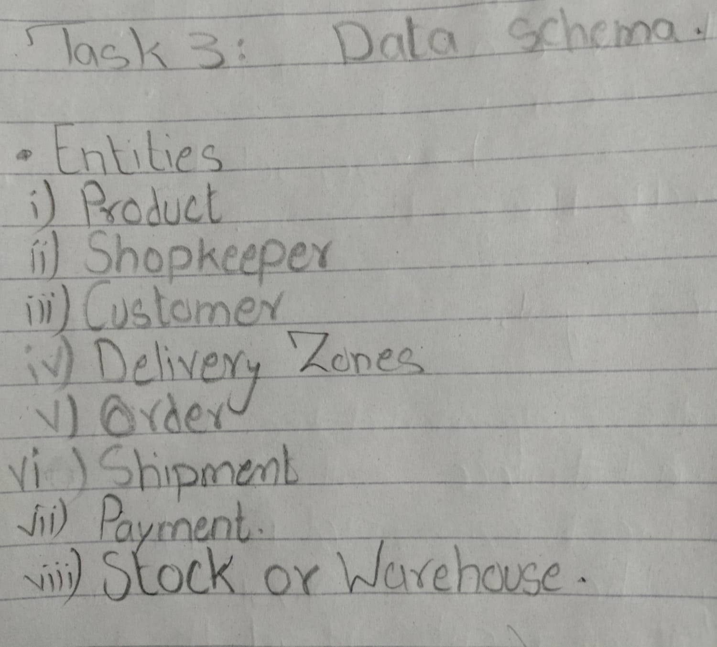
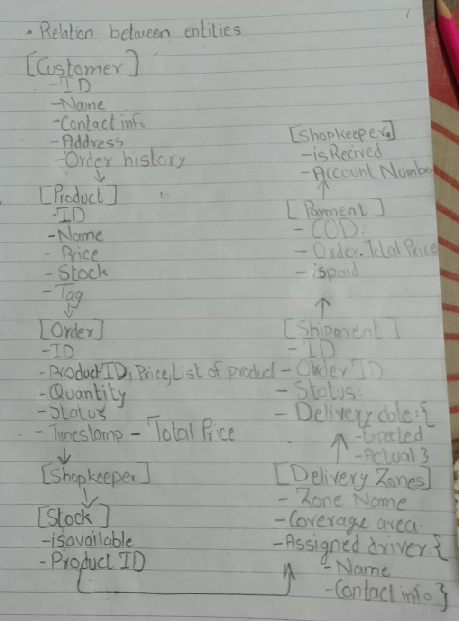
DATA SCHEMA

